Slide 1
Introduction to Computer Programming Lecture 11.2:
Review : Control Flow & Loops
Hemma Philamore
Department of Engineering Mathematics

Slide 2

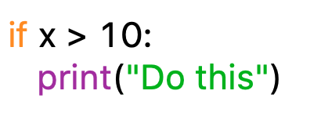
Conditional Statements
Making decisions in a program
If : Runs the block of code only if the condition is true.
x
conditional
colon
x > 10
True
False
Do this!
indentation
Further code

Slide 3
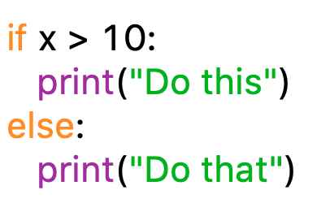
Conditional Statements
If... else...
Runs the block of code under “if” only if the condition is true.
Runs the “else” code otherwise.
conditional
colon
colon
x > 10
indentation
indentation
if
True
False
else
Do this!
Do that!
Further code

Slide 4

Conditional Statements
else
False
False
x > 10
x < 10
x = 10
if
True
else if
True
Do this!
Do that!
Do something else!
conditional
indentation
Further code
conditional
indentation
If... elif.. else...
Runs the block of code under “if” only if the condition is true.
Otherwise, runs the block of code under “elif” only if the condition is true.
Otherwise, runs the “else” code otherwise.

Slide 5
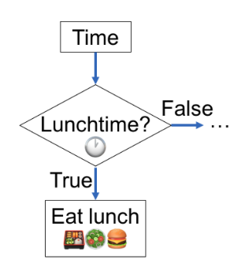


Slide 6
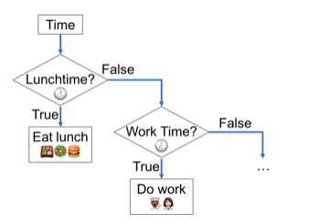

Slide 7
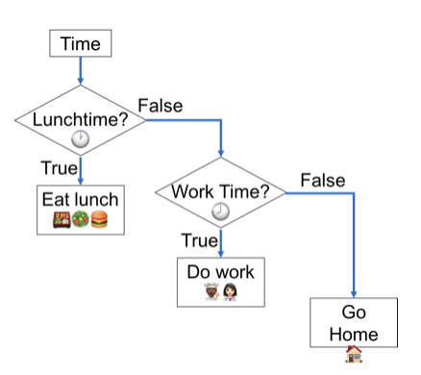

Slide 8
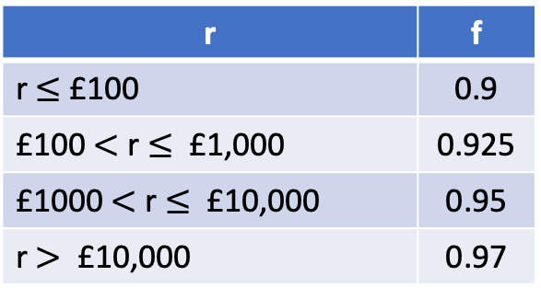
Q11.2.A
A UK currency conversion company calculates the amount received by the customer as:
r = p * m * f
r = amount received by customer
p = amount paid by customer (GBP £)
m = market conversion rate
f = scale factor (depends on r)
m depends on the currency being bought.
For US dollars $, m = 1.36
f depends on the amount paid:
Write a program using conditional statements to calculate r, for an input value, p.
r | f
r $≤$£100 | 0.9
£100$<$ r $≤$ £1,000 | 0.925
£1000$<$ r $≤$ £10,000 | 0.95
r $>$ £10,000 | 0.97

Slide 9

Loops
Do this!
4
Do this!
Do this!
Do this!
Do this!
Do this!
x<8
n iterations
condition
For Loop
While Loop

Slide 10
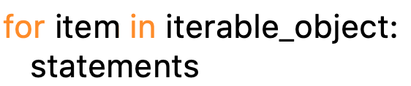
For Loop
Keyword ‘in’
Target: changes every iteration, a variable name
Keyword ‘for’
Colon
Indentation
Block of code carried out every iteration!
Use target value in a sensible way

Slide 11
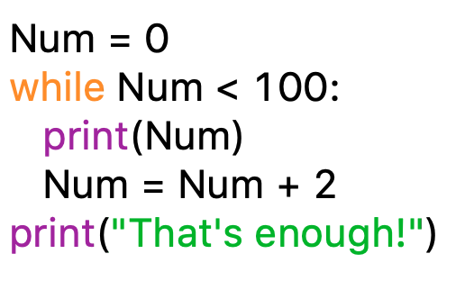
While Loop
Condition when to stop
Keyword ‘while’
Needs to include changes such that condition eventually can be negated

Slide 12
Q.11.2.B
Write a program that prints all the integers from 0 to 6 inclusive, using a loop.
Q.11.2.C
Write a program that prints every second element of a list, using a loop.
Q11.2.D
Write a program that requests a number from the user until the number input by the user is greater than 10.

Slide 13
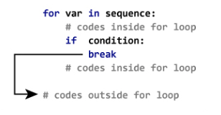
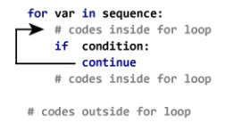
Break & Continue
Break
Sometimes we want to exit a for or while loop prematurely i.e skip all remaining values
Continue
Sometimes, instead of skipping all remaining values, we want to skip just one value in a loop.

Slide 14
Q.11.2.E
Write a program that prints all the integers from 0 to 6 inclusive, except 3 and 4, using a loop.
(Modify your answer to Q.11.2.B)
Q.11.2.F
Write a program that prints every element of a list of numbers, using a loop, exiting the loop before printing the number if a number greater than 10 is reached.

